Slide 1
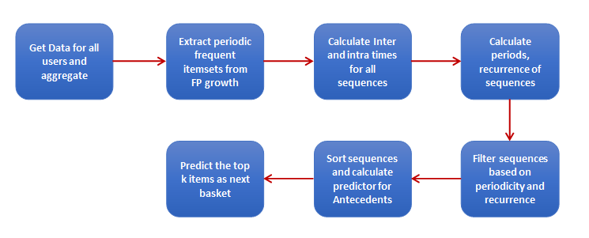
Client Ease of shopping has surged the popularity of e-commerce/ online grocery stores. To match-up to the customer demands and expectations the executive team need:
To understand the consumer purchasing behavior
To stock appropriate products and launch effective promotional campaigns
Our Solution Our objective was to capture the underlying buying behavior of each customer and design a recommendation engine that gives personal recommendation on the list of items to buy. We –
Built two models –
One to capture user specific patterns
Another to discover the overall patterns
Clustered users based on reordering patterns and product purchase patterns
Created an ensemble of all the above models
Challenges
Identify the customers likely to repeat their purchases
Recommend a list of grocery items the individual consumer is likely to purchase
Impact
We were able to recommend the next list of grocery items to individual customers with an accuracy of 80%

Slide 2
Technical
Feature Engineering for the Model
The objective of the recommendation model is to capture the buying patterns of every customer and design a generic recommendation engine which gives personal recommendation based on the underlying patterns.
Customers always tend to buy items in pairs/sets which can be termed as Co occurrence. Hence the first step of the algorithm uses periodic FP growth algorithm to mine frequent co-occurring items.
Groceries are purchased sequentially i.e. one item after other in sequence. Hence the next step for our model is to calculate intra-time which incorporates sequentiality into the model
A customer makes specific purchases only at specific periods of time in a year which can be modeled as periodicity. We calculate inter time for the sequences which is further used to calculate periods.
And it is observed that many of periodic patterns recur frequently. A recurrence parameter is also calculated for each sequence. At the end we have a set of recurrent sequences with each sequence having inter and intra times, periodicity and recurrence.
Predictive Modelling :
Once the sequences are generated, we filter out less recurring and periodic items. For each of remaining sequence, the antecedent is taken and unique predictor value is calculated based on three factors.
Support of Antecedent among sequences
Difference of last period occurrences and median number of occurrences among all periods
Difference of days since last precedent occurrence and median intra time
A predictor value is assigned for all the sequence - antecedents and top-k items are selected and recommended as next basket for the customer.

Slide 3
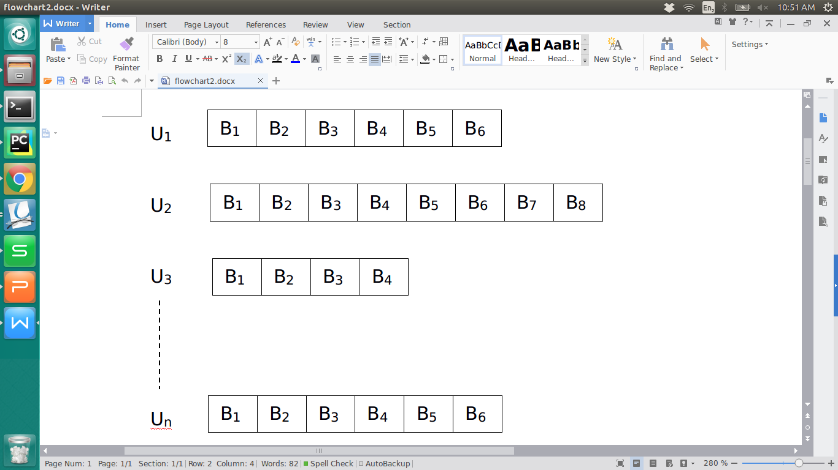
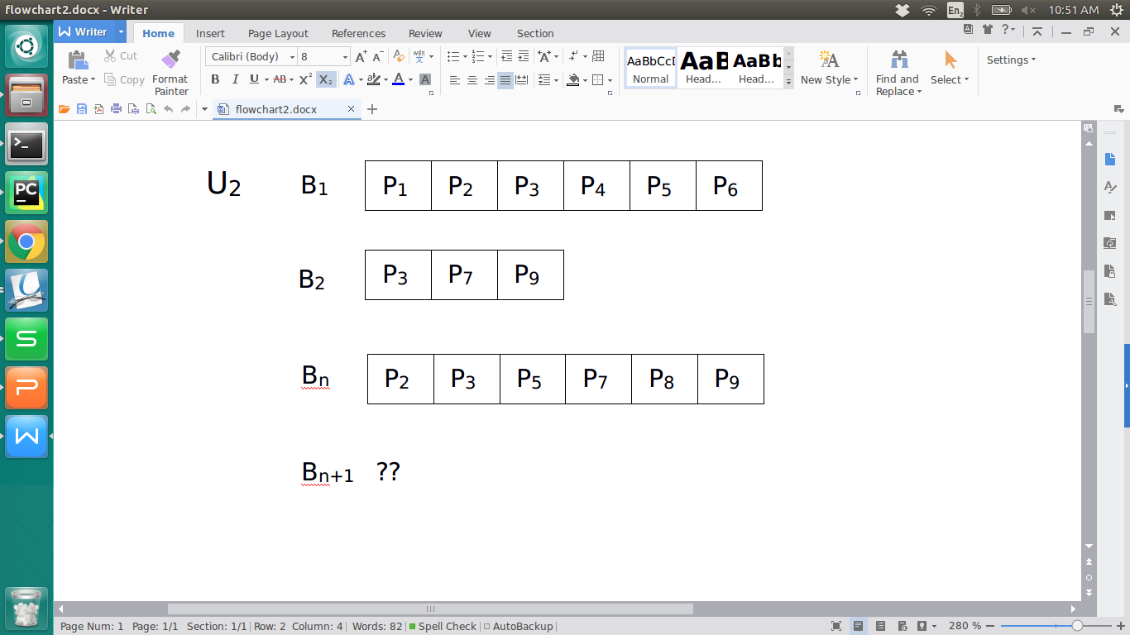
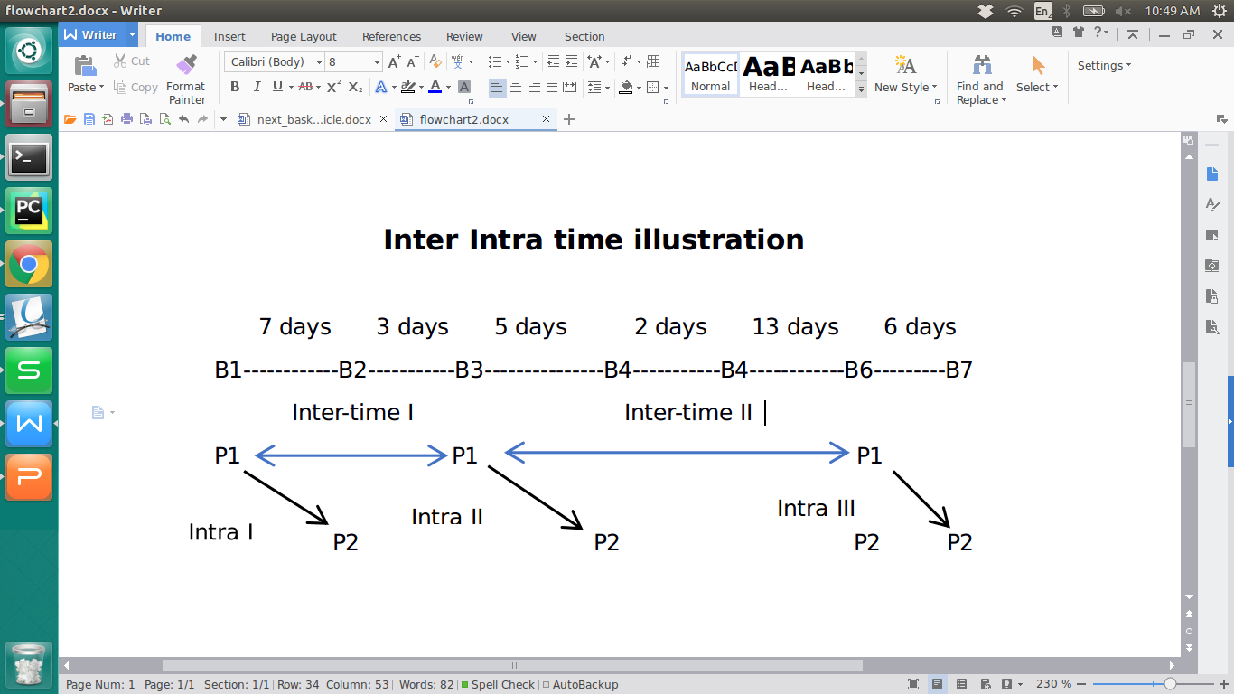
All Users data
Inter time and Intra time calculation
Extracting each user data

